Slide 1
Project
Student name : Parmeet Kaur
Student id: 100177502
Subject : Comp115
Instructor : Alice Wang

Slide 2
Introduction
In British Columbia it is evident that housing affordability is one of the major issue which need to address. In which lot of masses spend more than 30 % of their income on rent. This project will pay attention towards the rent burden and compares different regions.

Slide 3
Chosen Project
Data Analysis Project
2016 BC Housing Affordability

Slide 4
Objective
Analyze
Analyze housing affordability
Check
Check rental subsidy fairness
Use
Use BC Census 2016 data

Slide 5
About what in the presentation
Analyze house affordability .
Need to check subsidy fairness
Watch out BC census 2026 data
TASK 1: needs to pick up the areas which have > 50% spending 30 % income on rent.Moreover, analyzinging the income vs rent.
TASK 2 : comparison subsidy rated across regins.fraser,interior,northern,Vancouver coastal,Vancouver island.
TOOLS : python, pandas, data visualization
RESULTS: Identify high coastal areas.
difference across regins found.
CONCLUSION: suggestions regarding subsidy
policy adjustment required.

Slide 6
Tools & Skills
• Python for programming
• Pandas library for data analysis
Charts for data Visualization

Slide 7
Python code import pandas as pd import matplotlib.pyplot as plt # read data file data = pd.read_csv("bc_census_2016.csv") # -------- task 1 -------- # find areas with high rent high_rent = data[data["shelt_rent_30plus_rate"] > 50] plt.bar(high_rent["area_name"], high_rent["shelt_rent_30plus_rate"], color="blue") plt.title("High Rent Areas") plt.xlabel("Area") plt.ylabel("Percent") plt.xticks(rotation=45) plt.show() # -------- task 2 -------- # compare regions region_avg = data.groupby("region")["shelt_rent_30plus_rate"].mean() region_avg.plot( kind="pie", autopct="%1.1f%%", colors=["lightgreen", "orange", "pink", "violet", "lightgrey"] ) plt.title("Rent by Region") plt.ylabel("") plt.show()

Slide 8
Regional Comparison (Chart)

Slide 9
Task 1 Results
Areas with >50% renters spending high income on rent:
Richmond City Centre - 55.5%
Keremeos - 51.0%
Downtown Eastside - 53.6%
Shaughnessy/Arbutus Ridge/Kerrisdale - 50.2%
University of British Columbia - 65.7%

Slide 10
Task 2: Regional Comparison (Real Data)

Slide 11
Result
According to the research results, rent is more expensive in coastal areas while it is less expensive in interior and northern areas. This shows that home affordability fluctuates by region.

Slide 12
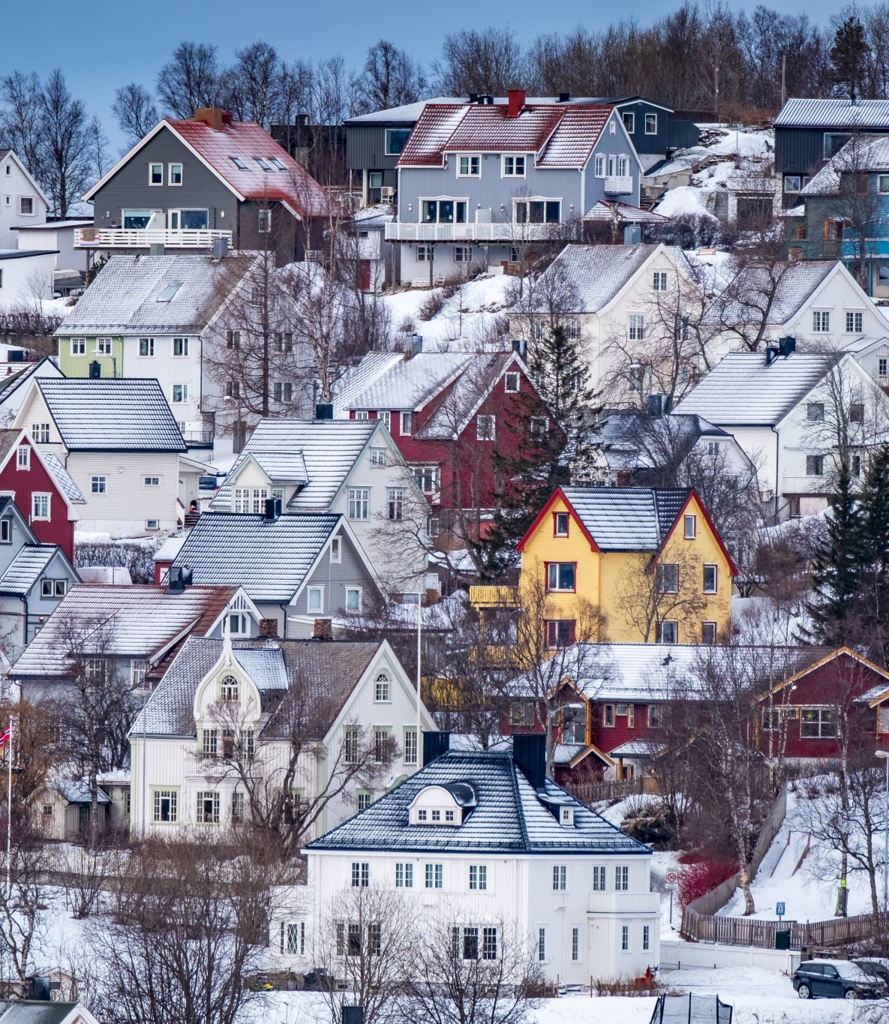
Conclusion
This project shows that housing affordability is a serious issue in British Columbia.
Coastal regions have higher rent burden compared to Interior and Northern regions.
The results suggest that housing support policies may not be equally effective across all regions.
Therefore, better and region-specific subsidy policies are needed.”

Slide 13
Thank you

